Slide 1


Final Project
Group 6
Babin Karki
Gisella Escobar
Karan Saxena
Laxmikant Mukkawar
Suman K C
Narayani Kangatharan
Proff: Omar Altrad - BAN110 ZAA
Aug 2022

Slide 2
Introduction
Retaining existing customers is generally easier and less expensive than acquiring new customers.
Researchers from Harvard Business School state that increasing customer retention rates by 5% may increase profits by 25%to 95%. Therefore, most companies in the Banking industry focus their efforts and resources in retaining existing customers, which translates into reducing attrition.
If the Bank can identify which customers are most likely to leave (churn), the Marketing team can proactively focus on retaining them.
Attrition is typically calculated by dividing the number of customers lost by the end of the period divided by the total number of customers at the beginning of the period.

Slide 3
Objective
Apply data cleaning tools and techniques learnt throughout the course to check and correct errors in data and prepare data for analysis.
Goal: To find highlights on the Bank data that provides the Credit Card business information to develop customer retention campaigns by targeting customers with the highest propensity to churn (attrition).

Slide 4

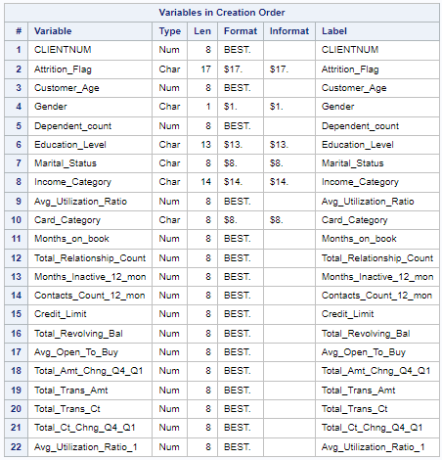
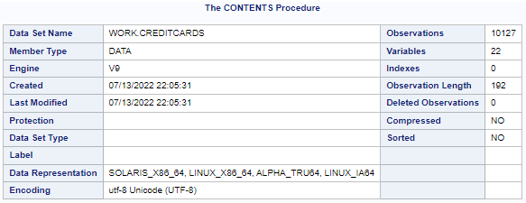
About the Data
we can see the data set structure.
Filename: Creditcards.xlsx
Data: The attrition dataset has 10,127 observations with 22 variables. The Target column is Attrition_Flag which will determine 2 classes in the Classification model.

Slide 5
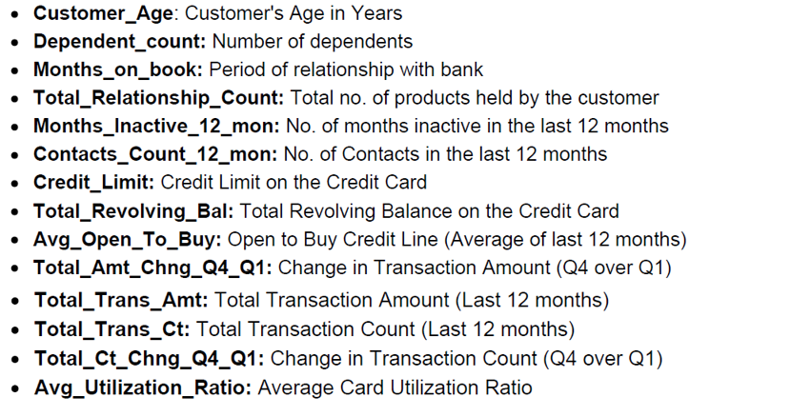
Numerical Variables

Slide 6
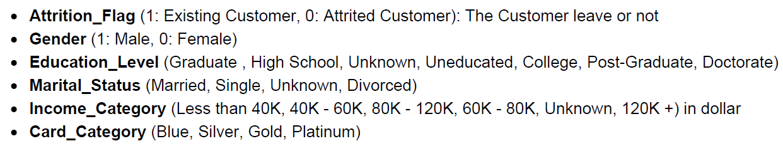
Categorical Variables

Slide 7
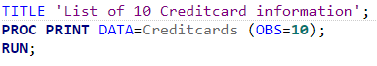
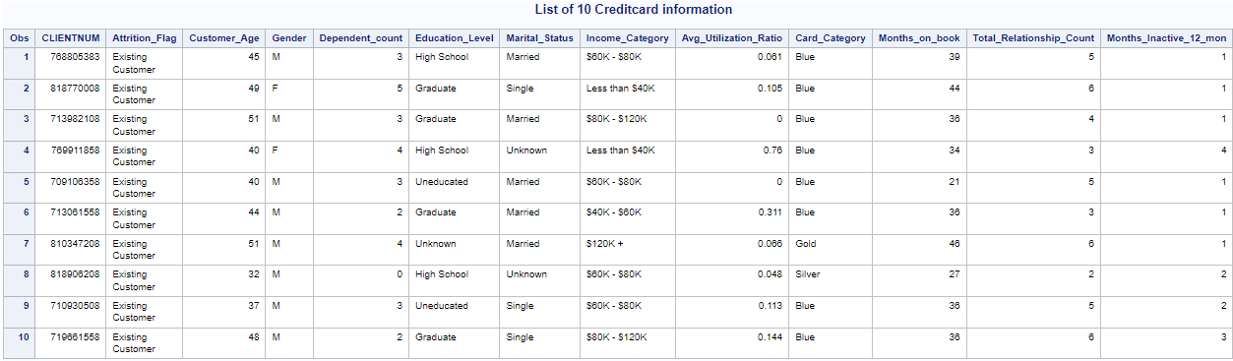
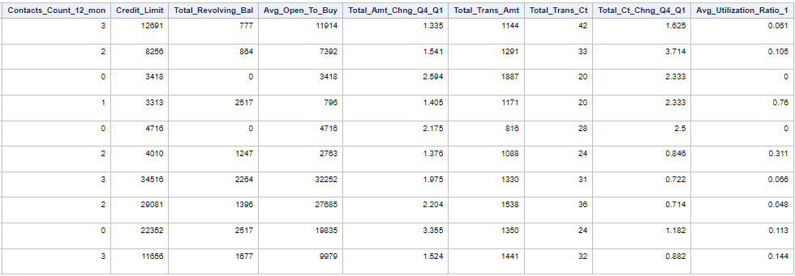
Sample Data

Slide 8

Target Variable: Attrition Flag
We are going to identify customers who exhibit high likelihood of attrition.
Therefore, the target variable will be the Attrition Flag, as follows:
Attrition Flag: 1 customers who closed the credit card account (churned customers)
Attrition Flag: 0 customers who remain with an active credit card (existing customers)

Slide 9
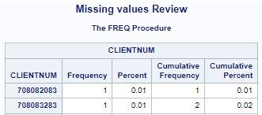
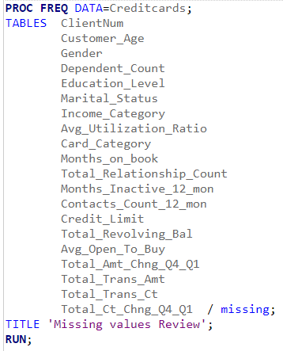
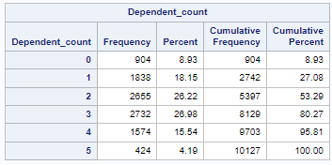
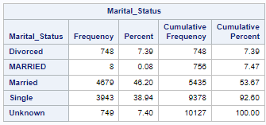
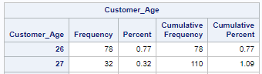
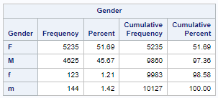
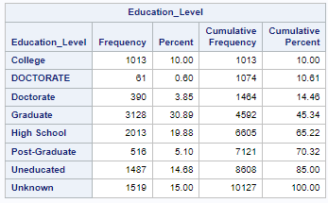
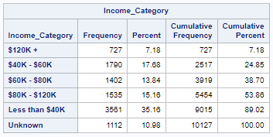
1. Analyzing the variables…
Executing the PROC FREQ for all the variables, we can see if there are missing values in any variable of the Dataset and if there is any error

Slide 10
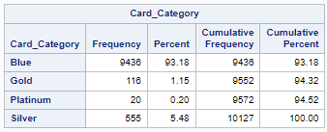
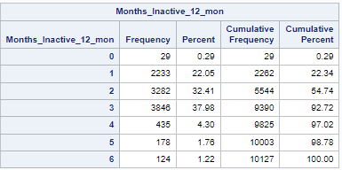
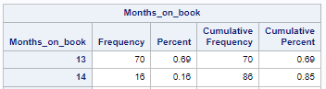
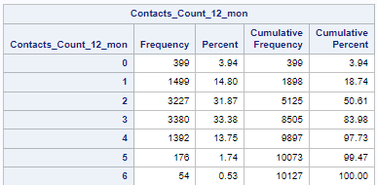
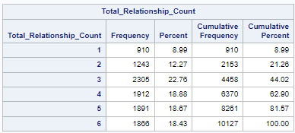
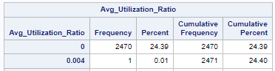
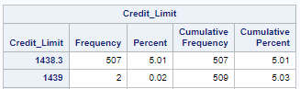
1. Analyzing the variables…
Executing the PROC FREQ for all the variables, we can see if there are missing values in any variable of the Dataset or if there is some data out of the possible values (data with lower and upper case).

Slide 11
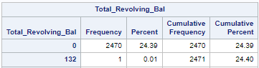
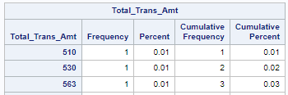
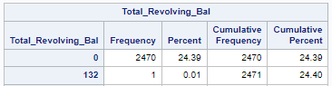
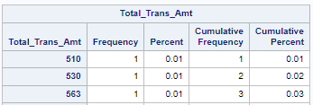
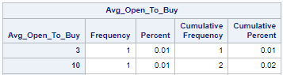
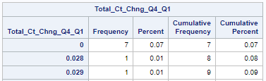
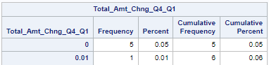
1. Analyzing the variables
Executing the PROC FREQ for all the variables, we can see if there are missing values in any variable of the Dataset or if there is some data out of the possible values (data with lower and upper case).

Slide 12
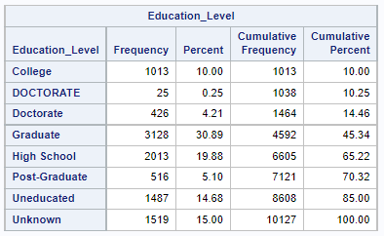
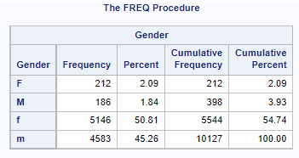
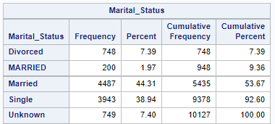
Findings …
Executing the PROC FREQ we didn’t identify missing values, but did identify corrections to be done in the data of these variables:
We are going to convert MARRIED in lowercase.
We are going to convert F and M in lowercase.
We are going to convert DOCTORATE in lowercase.

Slide 13
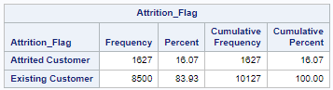
Findings
Executing the PROC FREQ we didn’t identify missing values, but we are going to transform the variable into binary variable :
Attrition Flag: 1 for “Attrition Customer (churned customers).
Attrition Flag: 0 for Existing Customer.
Attrition_Flag: will be transformed

Slide 14
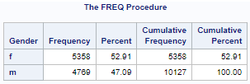
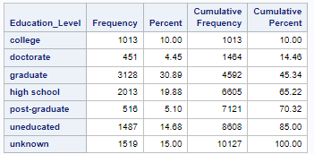
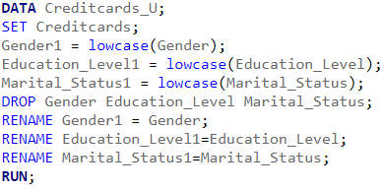
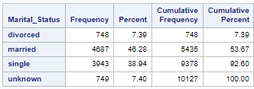
Corrections
Executing the next code, we updated the variables with lowercase to unify the data:

Slide 15
Data Exploration
Exploring the dataset and its key features, we observed that "Customer Age" and "Months on Books" show a Normal distribution, while other numerical features such as "Credit Limit", "Average Utilization Ratio", "Average Open to Buy" and "Total Transactions Count" show a skewed distribution.
This is not an issue given we will use a 2-class/binary classification model to address the business problem, where there are no assumptions on linearity or normality.
For the categorical variables, we observed there is no evident difference in the distribution for the 2 classes, i.e., both existing and churned customers show similar profile in terms of gender, education level, marital status, etc.

Slide 16
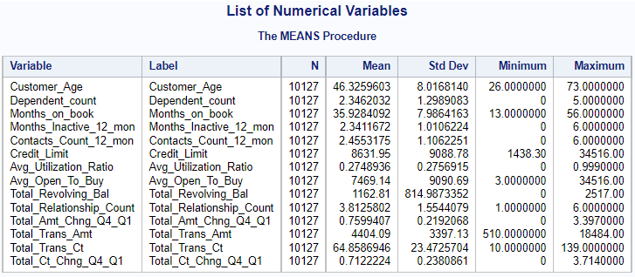
Exploring Numerical Variables

Slide 17
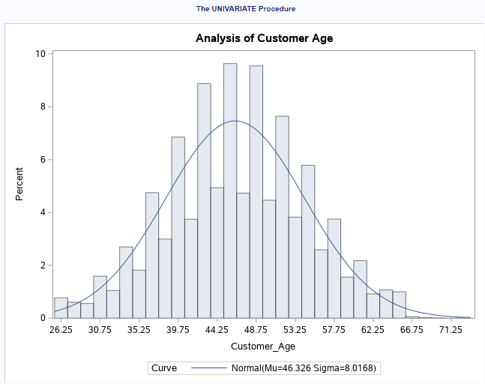
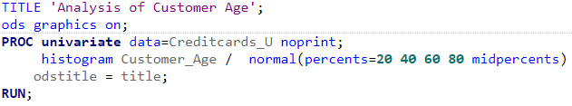
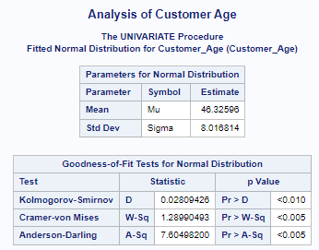
Data Exploration: Customer_Age

Slide 18
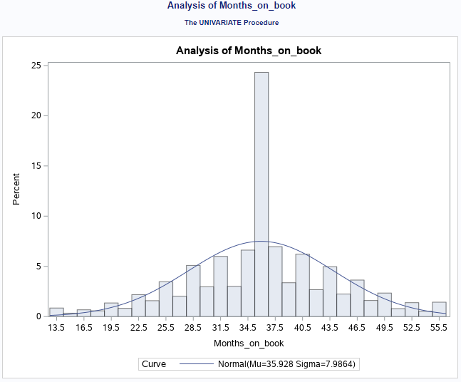
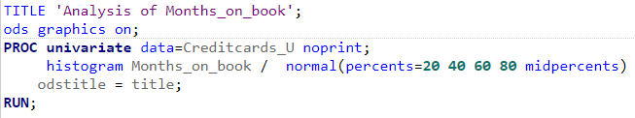
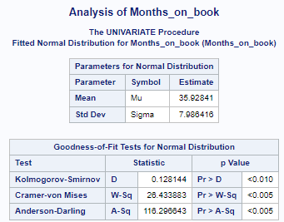
Data Exploration: Months of Book

Slide 19
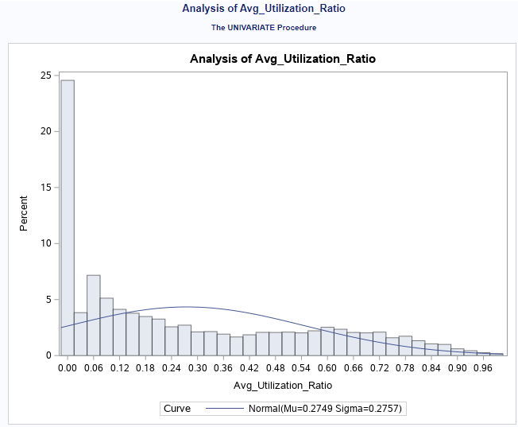
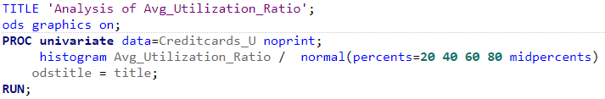
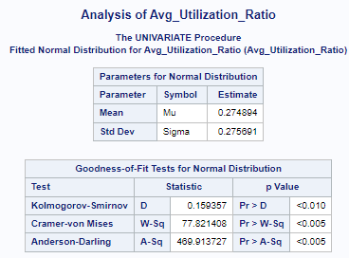
Data Exploration: Avg Utilization Ratio

Slide 20
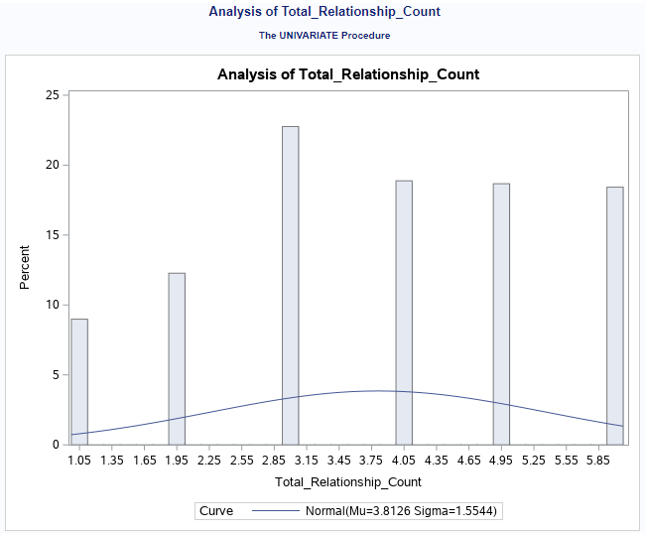
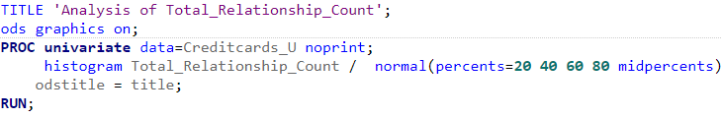
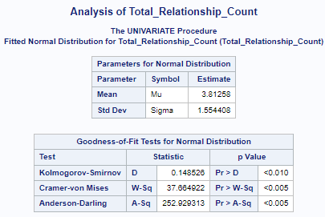
Data Exploration: Total Relationship Count

Slide 21



Data Exploration: Months Inactive12mon

Slide 22



Data Exploration: Contacts Count 12mon

Slide 23



Data Exploration: Credit Limit

Slide 24



Data Exploration: Total Revolving Balance

Slide 25



Data Exploration: Avg Open To Buy

Slide 26



Data Exploration: Total Amt Chng Q4_Q1

Slide 27



Data Exploration: Total Trans Amount

Slide 28



Data Exploration: Total Trans Ct

Slide 29



Data Exploration: Total Ct Chng Q4_Q1

Slide 30
Exploring Categorical Variables

Slide 31



Data Exploration: Gender

Slide 32



Data Exploration: Attrition Flag

Slide 33


Data Exploration: Education Level

Slide 34


Data Exploration: Marital Status

Slide 35


Data Exploration: Income Category

Slide 36


Data Exploration: Card Category

Slide 37

Converting Categorical Values in Numerical Values

Slide 38



Data Preparation: Attrition Flag
‘Existing Customer’ ➔ Attrition_Flag: 0
‘Attrition Customer’ ➔ Attrition_Flag: 1
Transformation

Slide 39



Data Preparation: Gender
M ➔ Gender: 1
F ➔ Gender: 0
Transformation

Slide 40



Data Preparation: Education Level
“unknown” ➔ Education_Level: 0
“uneducated” ➔ Education_Level: 1
“high school” ➔ Education_Level: 2
“college” ➔ Education_Level: 3
“graduate” ➔ Education_Level: 4
“post-graduate” ➔ Education_Level: 5
“doctorate” ➔ Education_Level: 6
Transformation

Slide 41



Data Preparation: Marital Status
“unknown” ➔ Marital_Status: 0
“single” ➔ Marital_Status: 1
“married” ➔ Marital_Status: 2
“divorced” ➔ Marital_Status: 3
Transformation

Slide 42



Data Preparation: Income Category
“unknown” ➔ Income_flag: 0
“Less than $40K” ➔ Income_flag: 1
“$40K - $60K” ➔ Income_flag: 2
“$60K - $80K” ➔ Income_flag: 3
“$80K - $120K” ➔ Income_flag: 4
“$120K +” ➔ Income_flag: 5
Transformation

Slide 43



Data Preparation: Card Category
“Blue” ➔ Card_Category: 1
“Silver” ➔ Card_Category: 2
“Gold” ➔ Card_Category: 3
“Platinum” ➔ Card_Category: 4
Transformation

Slide 44


Identifying Outliers
For each numeric variable, we applied the Standard Deviation Method to identify outliers.
Based on the results and the business knowledge, we removed outliers for the “Credit Limit” variable. For the dataset Credit Limit shouldn’t exceed $25,000, based on the company policy.
For the other numeric variables, we concluded that outliers are in line with the business rules and customer behaviour (Average Utilization Rate, Months on Books, etc).
Bellow is an example of the code used. In the following slides, will show the outlier analysis for each variable.

Slide 45



Outliers for Customer Age (Result)

Slide 46



Outliers for dependent count(Avg. Utilization Ratio)

Slide 47



Outliers for Months on Books

Slide 48



Outliers for Total Relationship Count

Slide 49



Outliers for Months inactive (Total12 months)

Slide 50



Outliers for Credit Limit

Slide 51



Outliers for Total Revolving Balance

Slide 52



Outliers for Average Open to Buy

Slide 53



Outliers for Total Transaction Amount

Slide 54



Outliers for Total Amount Change(Q1-Q4)

Slide 55



Outliers for Total Transaction Cut

Slide 56



Outliers for Total Cut Change(Q1-Q4)

Slide 57



Outliers for Average Utilization Ratio

Slide 58
Transformations

Slide 59



Removing Outliers: Credit Limit
Before
This is the information Before and After removing outliers.
After
This population is skewed to the right where mean is $5,929.41.
After the removal of outliers (133) we observed there are new outliers. This is due to the profile of credit limits in this particular portfolio, where most % of credit limits are less than $10,000.

Slide 60

Final Recommendations
Based on the final analysis of the dataset, Marketing should focus its retention campaigns on customers with "high school" and "graduate" education level that account for 48% of churn. Additionally, the updating of the data referring to the “unknown” level of education should be updated with correct information in order to have better information, since this represents 18%.
“unknown” ➔ Education_Level: 0
“uneducated” ➔ Education_Level: 1
“high school” ➔ Education_Level: 2
“college” ➔ Education_Level: 3
“graduate” ➔ Education_Level: 4
“post-graduate” ➔ Education_Level: 5
“doctorate” ➔ Education_Level: 6

